Slide 1
Ethernet (CSMA/CD)
Carriers Sense Multiple Access with Collision Detection
Xerox - Ethernet
IEEE 802.3

Slide 2
CSMA/CD
With CSMA, collision occupies medium for duration of transmission
Stations listen whilst transmitting
If medium idle, transmit, otherwise, step 2
If busy, listen for idle, then transmit
If collision detected, jam then cease transmission
After jam, wait random time then start from step 1

Slide 3
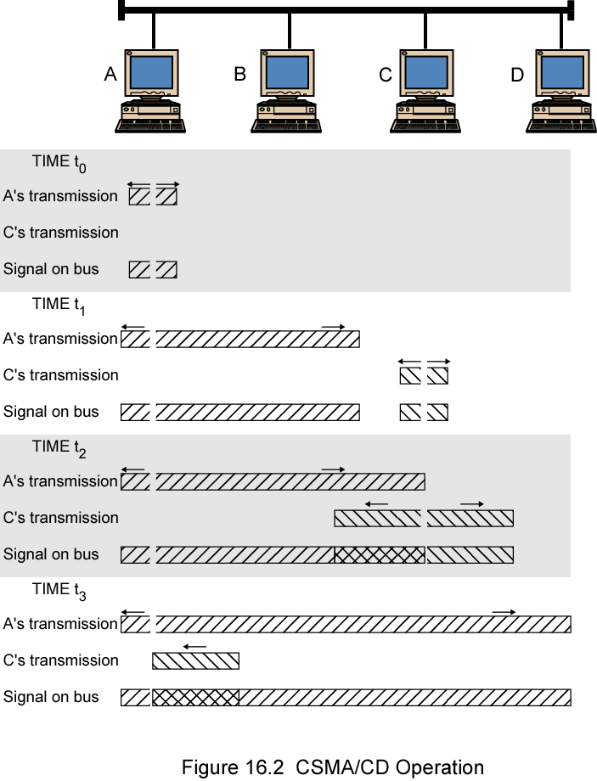
CSMA/CD
Operation

Slide 4
Collision Detection
On baseband bus, collision produces much higher signal voltage than signal
Collision detected if cable signal greater than single station signal
Signal attenuated over distance
Limit distance to 500m (10Base5) or 200m (10Base2)
For twisted pair (star-topology) activity on more than one port is collision
Special collision presence signal

Slide 5
Gigabit Ethernet – Physical
1000Base-SX
  Short wavelength, multimode fiber
1000Base-LX
  Long wavelength, Multi or single mode fiber
1000Base-CX
  Copper jumpers <25m, shielded twisted pair
1000Base-T
  4 pairs, cat 5 UTP
Signaling - 8B/10B

Slide 6
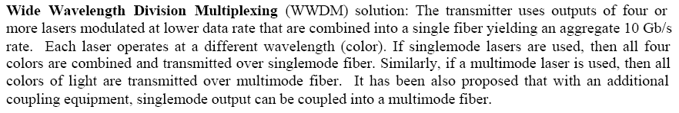

Slide 7
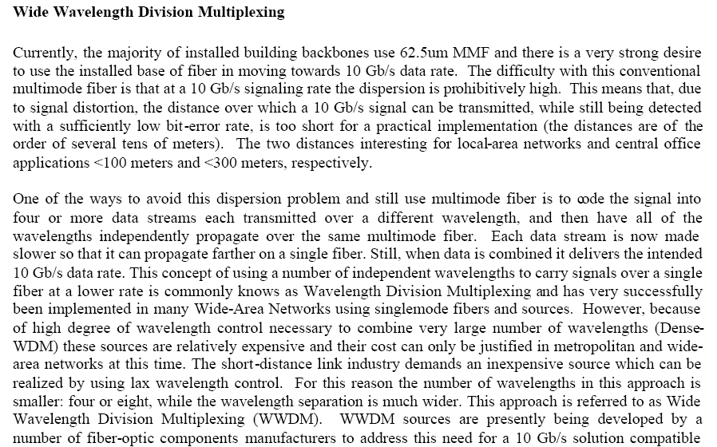

Slide 8
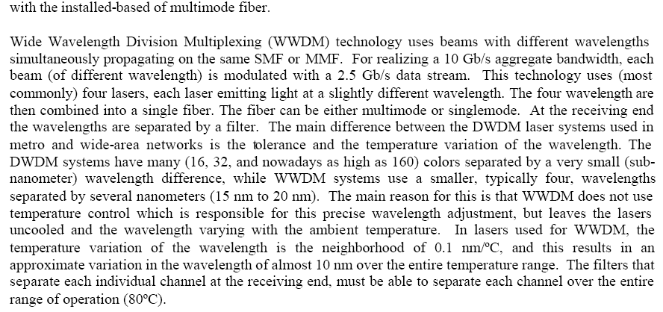

Slide 9
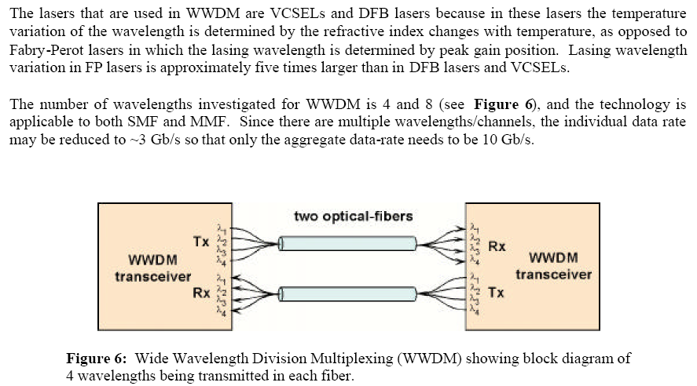

Slide 10
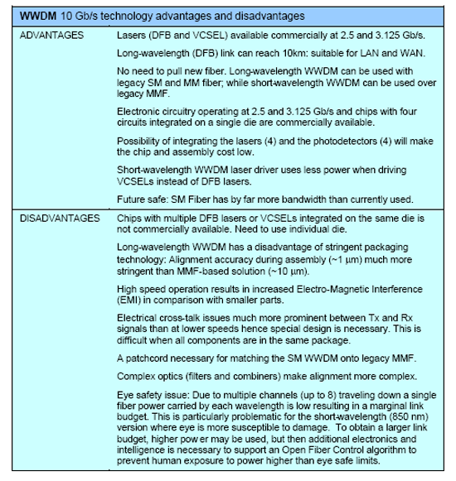

Slide 11
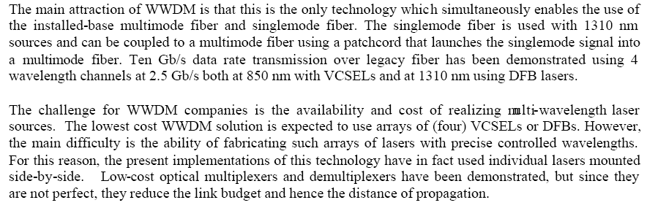

Slide 12
Why Change IP?
Address space exhaustion
  Two level addressing (network and host) wastes space
  Network addresses used even if not connected to Internet
  Growth of networks and the Internet
  Extended use of TCP/IP
  Single address per host
Requirements for new types of service

Slide 13
IPv6 Enhancements (1)
Expanded address space
  128 bit
Improved option mechanism
  Separate optional headers between IPv6 header and transport layer header
  Most are not examined by intermediate routes
    Improved speed and simplified router processing
    Easier to extend options
Address autoconfiguration
  Dynamic assignment of addresses

Slide 14
IPv6 Enhancements (2)
Increased addressing flexibility
  Anycast - delivered to one of a set of nodes
  Improved scalability of multicast addresses
Support for resource allocation
  Replaces type of service
  Labeling of packets to particular traffic flow
  Allows special handling
  e.g. real time video

Slide 15
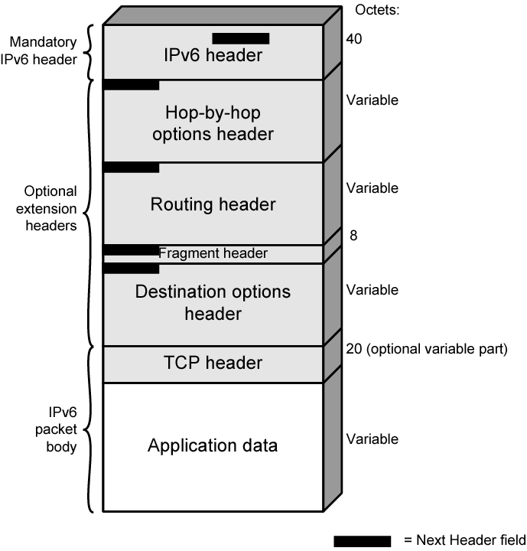
IPv6
Structure

